Slide 1
Tutorial 1 Learning Topology Optimization Through Examples and Case Studies
August 18, 2019

Slide 2
Manufacturing Constraints

Slide 3
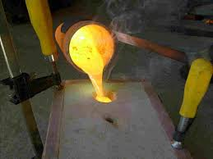
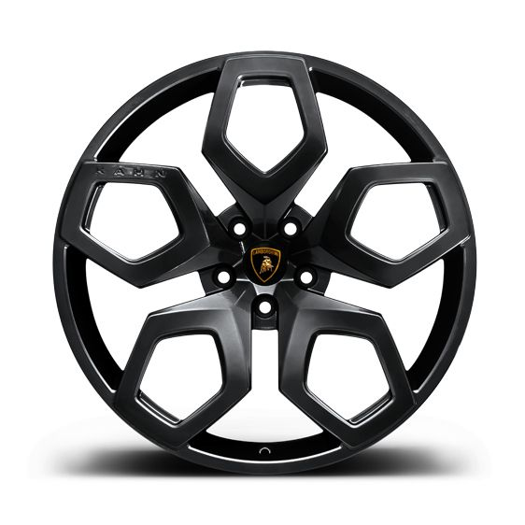
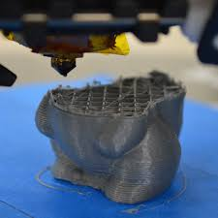
Manufacturing Constraints
Draw Direction
Through Cut
https://www.ametals.com/capabilities/laser-cutting/
Cyclic
Symmetry
http://foundry101.com/
Minimum Feature Size
Retaining
Surfaces

Slide 4
Goal
Goal: Optimized designs can be fabricated directly
Option 1:
Then
Optimizing design
Considering manufacturing requirements
Post-process
Sub-optimal
Option 2:
While
Optimizing design
Considering manufacturing requirements
Embedded within TO
Optimal
How?!

Slide 5
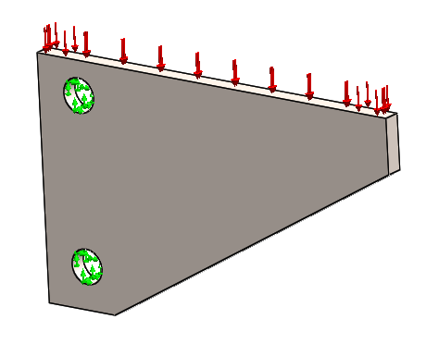
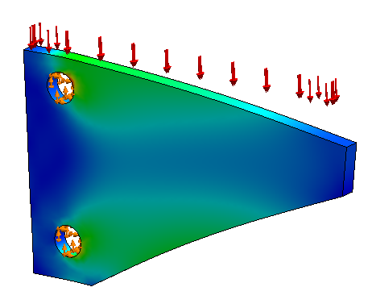
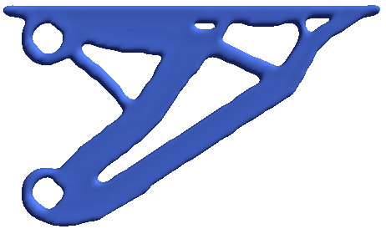
TopOpt Workflow
Yes
Optimization Problem
FEA
Done?
No
Remove Material
Filter Sensitivity
Sensitivity Analysis

Slide 6
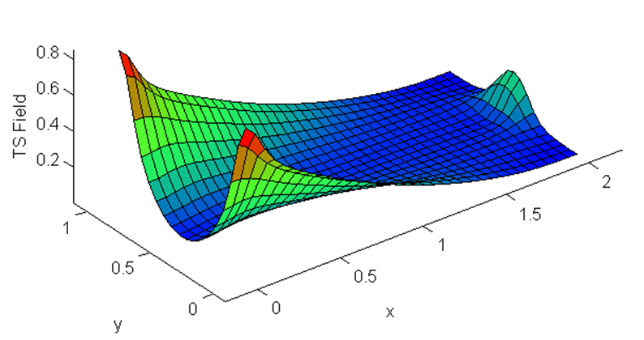
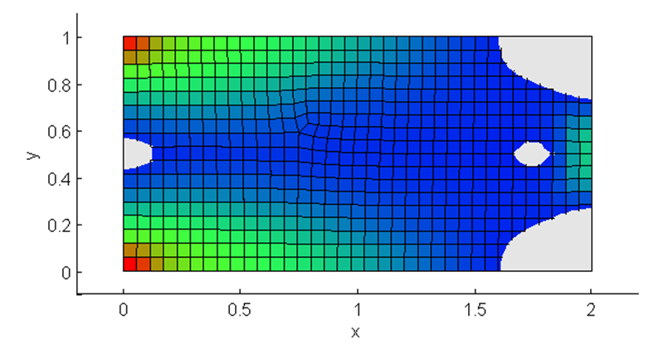
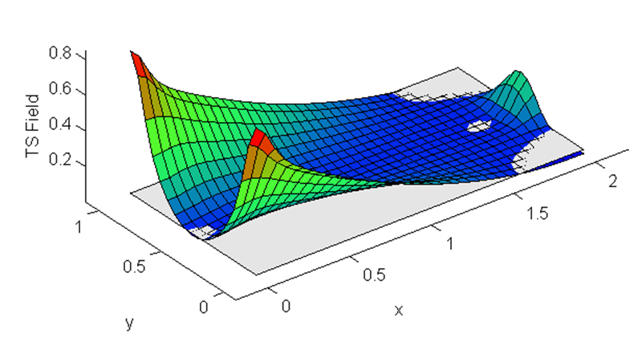
Filter Sensitivity
1) Initial design
2) TS Field
3) Cut-off value
4) Remove material
Prevent introduction of trapped holes! How?

Slide 7
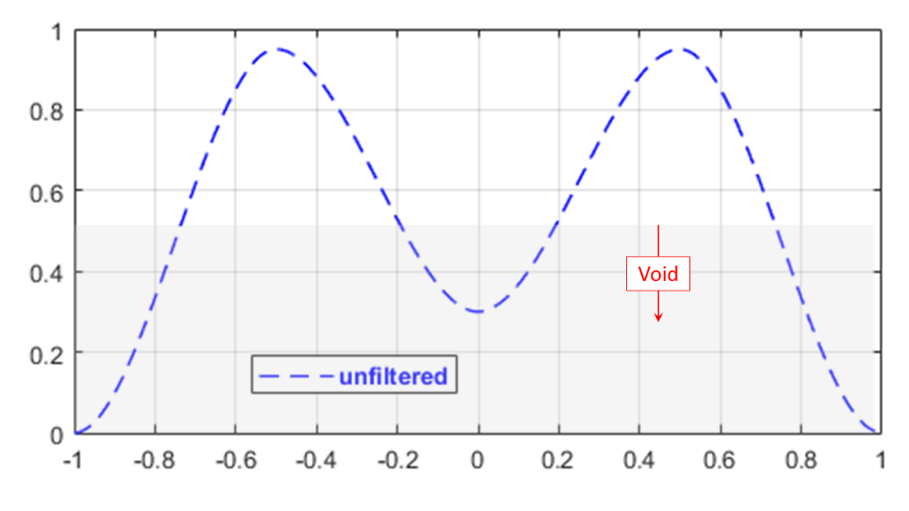
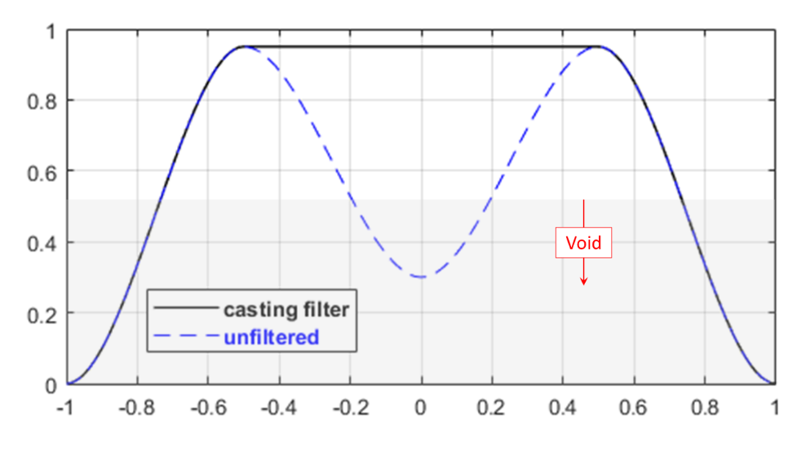
Filter Sensitivity
Change or filter sensitivity field to change where to remove material!

Slide 8
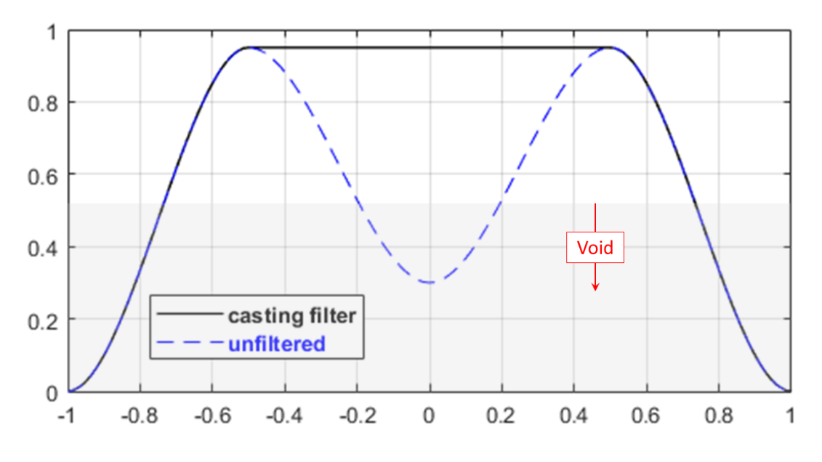
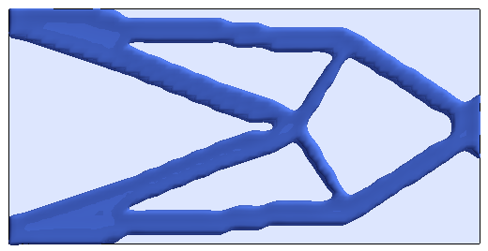
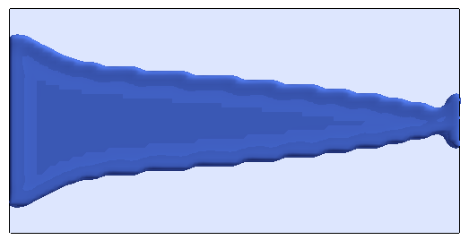
Filter Sensitivity
Unfiltered
Filtered

Slide 9
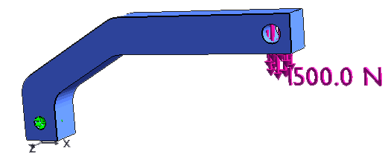
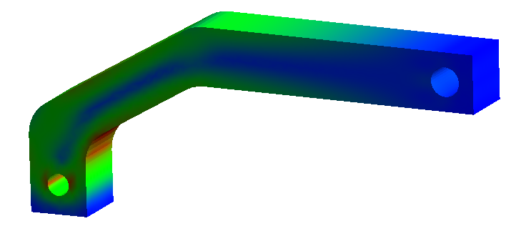
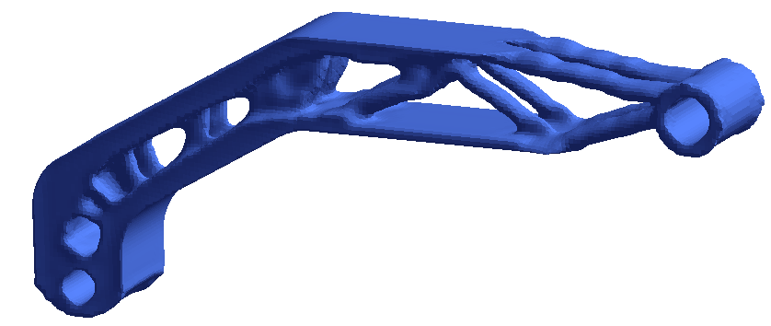
Swing Arm Example
1) Structural problem
2) FEA
3) Optimized design

Slide 10
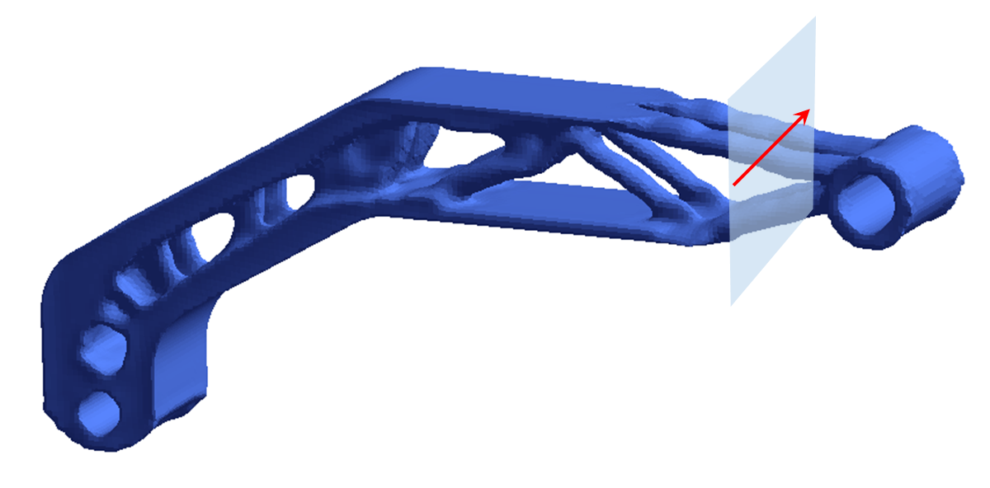
Sensitivity Field at a Cross-Section

Slide 11
Manufacturing Constraints
Draw Direction
Through Cut
https://www.ametals.com/capabilities/laser-cutting/
Cyclic
Symmetry
http://foundry101.com/
Minimum Feature Size
Retaining
Surfaces

Slide 12
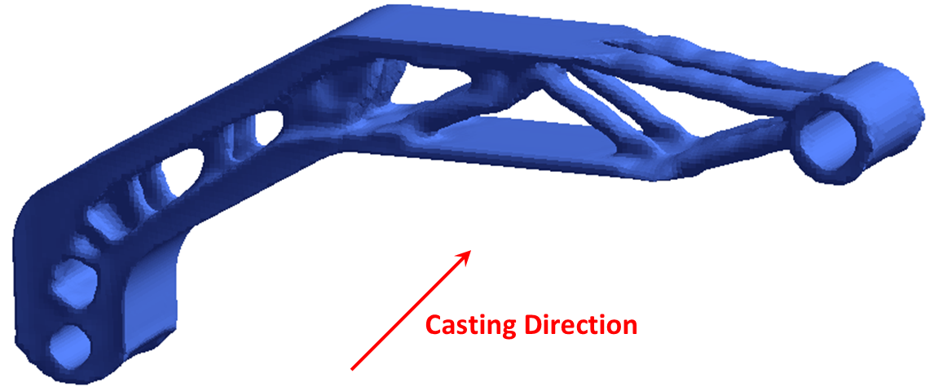
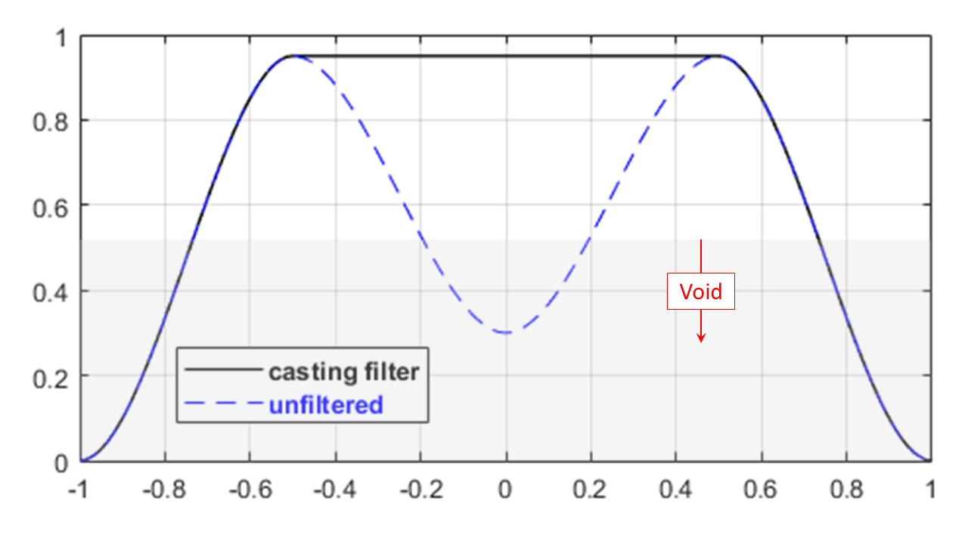
Draw-Direction Constraint
No trapped cavities along
the casting direction!

Slide 13
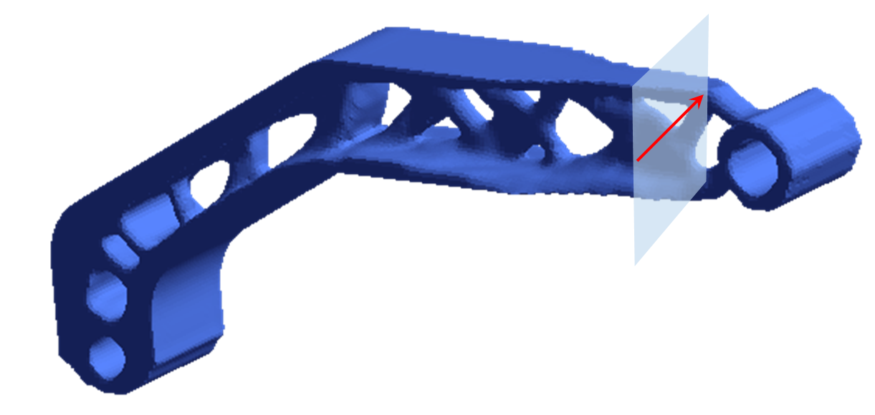
Draw-Direction Constraint on Sensitivity Field
No trapped cavities along
the casting direction!

Slide 14
Manufacturing Constraints
Draw Direction
Through Cut
https://www.ametals.com/capabilities/laser-cutting/
Cyclic
Symmetry
http://foundry101.com/
Minimum Feature Size
Retaining
Surfaces

Slide 15
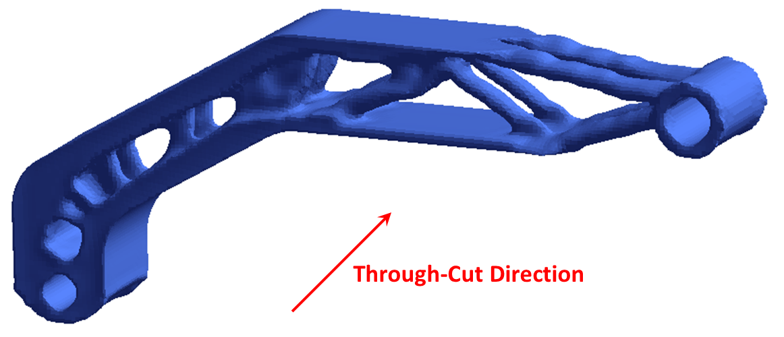
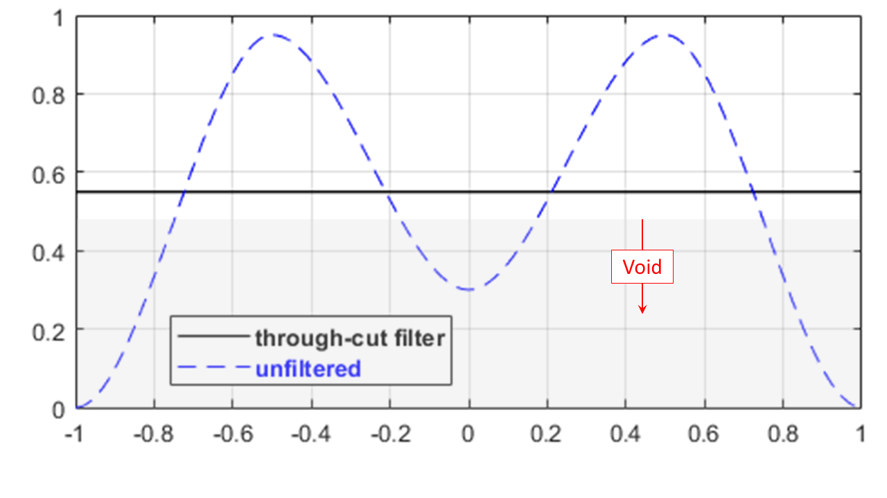
Through-Cut Constraint
Uniform cross-section along
the through-cut direction!

Slide 16
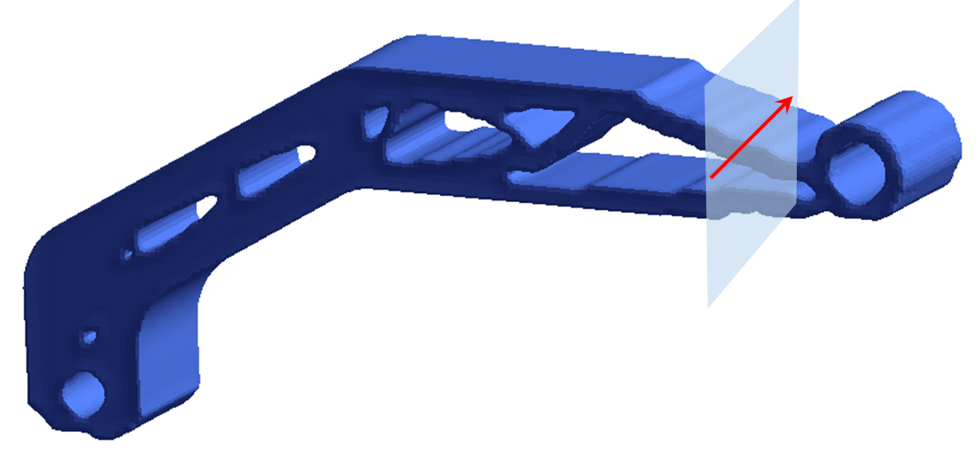
Through-Cut Constraint on Sensitivity Field
Uniform cross-section along
the through-cut direction!

Slide 17
Manufacturing Constraints
Draw Direction
Through Cut
https://www.ametals.com/capabilities/laser-cutting/
Cyclic
Symmetry
http://foundry101.com/
Minimum Feature Size
Retaining
Surfaces

Slide 18
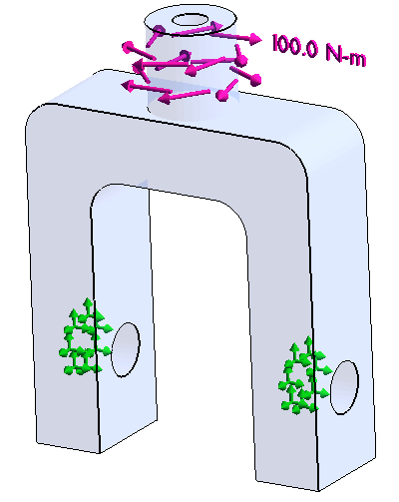
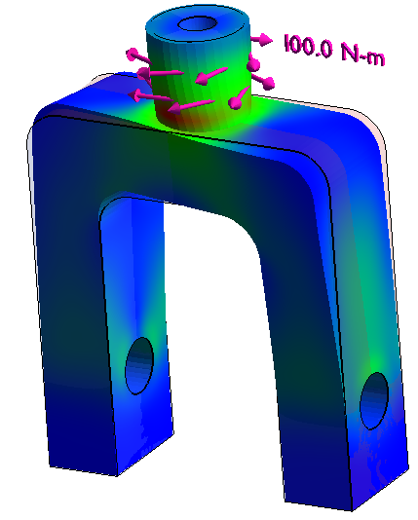
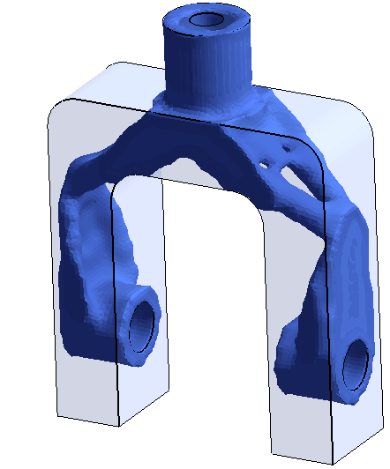
Knuckle Example
1) Structural problem
2) FEA
3) Optimized design

Slide 19
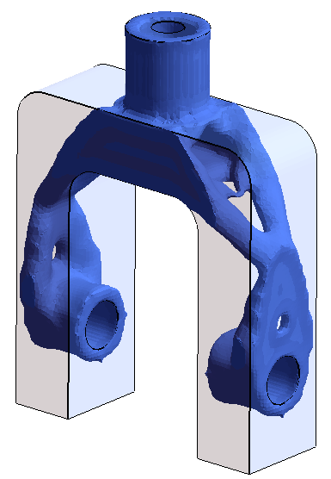
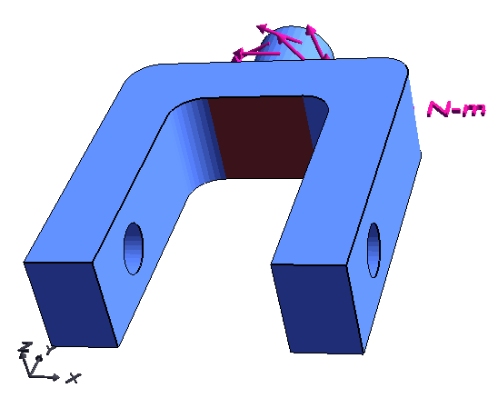
Retain face
Original problem:
Retained-face problem:

Slide 20
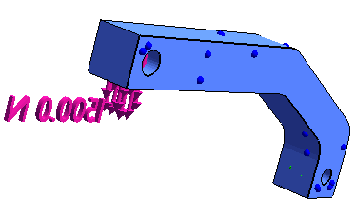
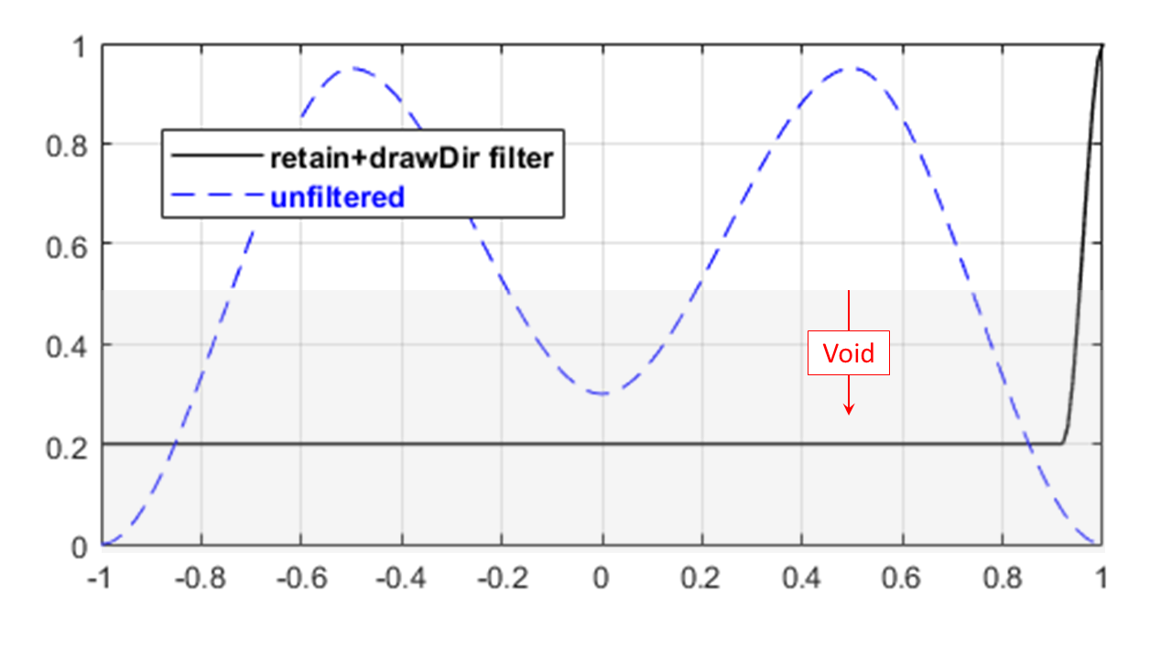
Swing Arm w/ Retain + Draw Dir. Constraint
Retain selected surfaces!

Slide 21
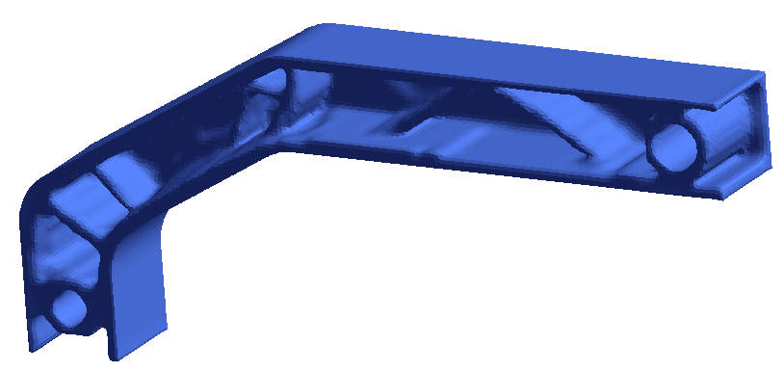
Retain Constraint on Sensitivity Filter
Retain selected surfaces!

Slide 22
Manufacturing Constraints
Draw Direction
Through Cut
https://www.ametals.com/capabilities/laser-cutting/
Cyclic
Symmetry
http://foundry101.com/
Minimum Feature Size
Retaining
Surfaces

Slide 23
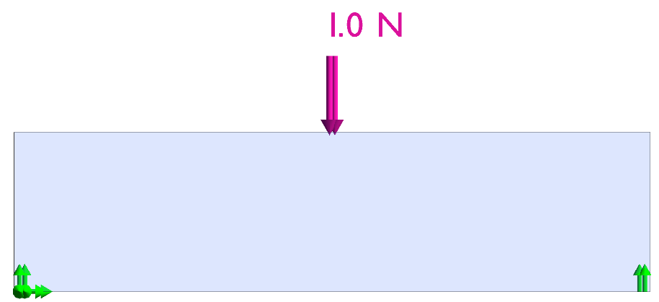
MBB Beam Example
1) Structural problem
2) FEA
3) Optimized design

Slide 24
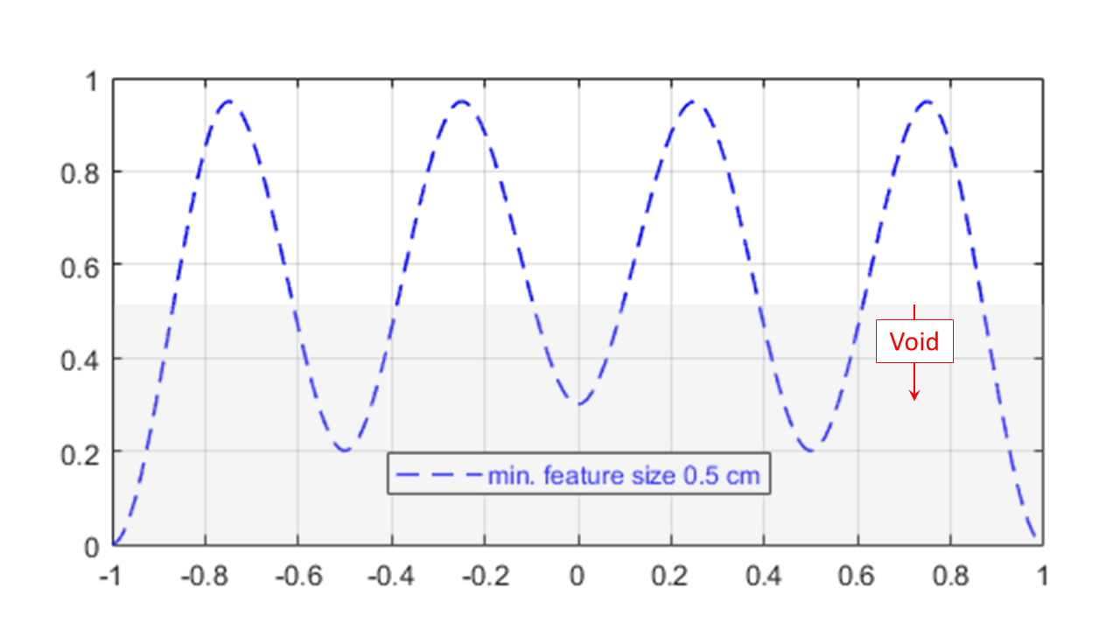
Sensitivity Field

Slide 25
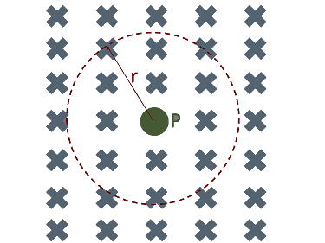
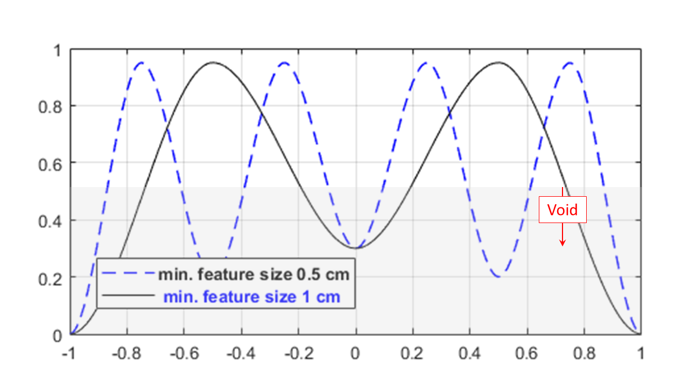
Smoothing Filter on Sensitivity Field

Slide 26
Manufacturing Constraints
Draw Direction
Through Cut
https://www.ametals.com/capabilities/laser-cutting/
Cyclic
Symmetry
http://foundry101.com/
Minimum Feature Size
Retaining
Surfaces

Slide 27
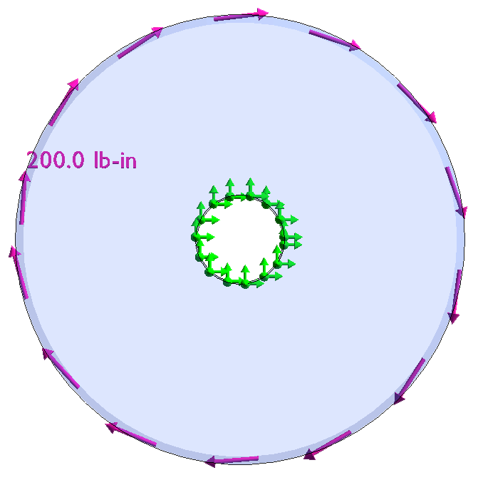
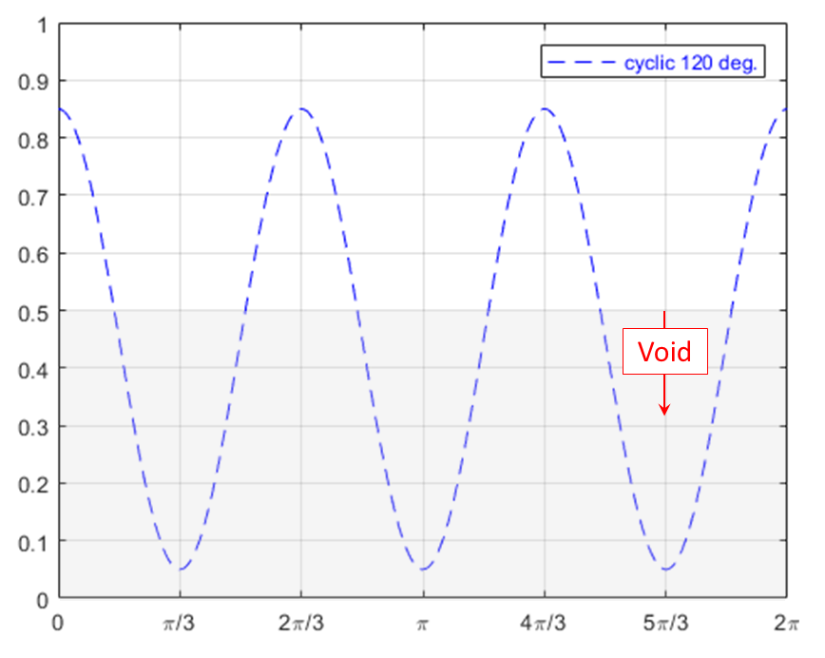
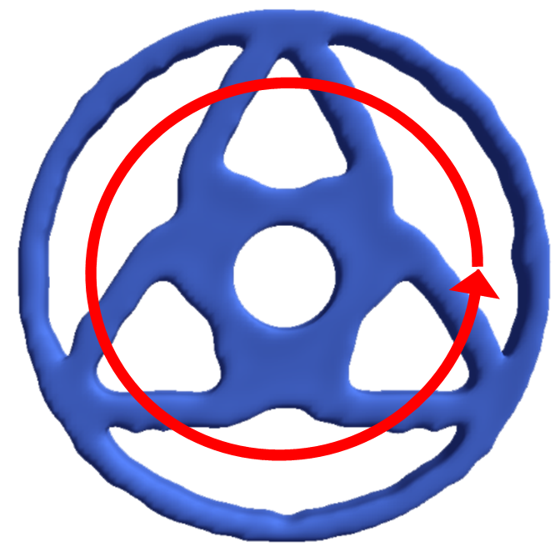
Circular Plate Example

Slide 28
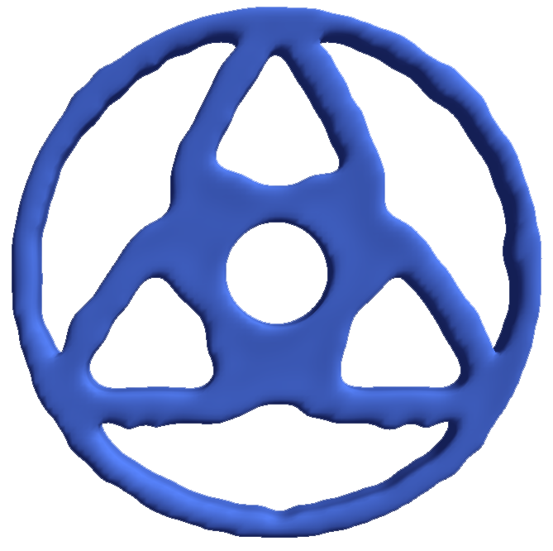
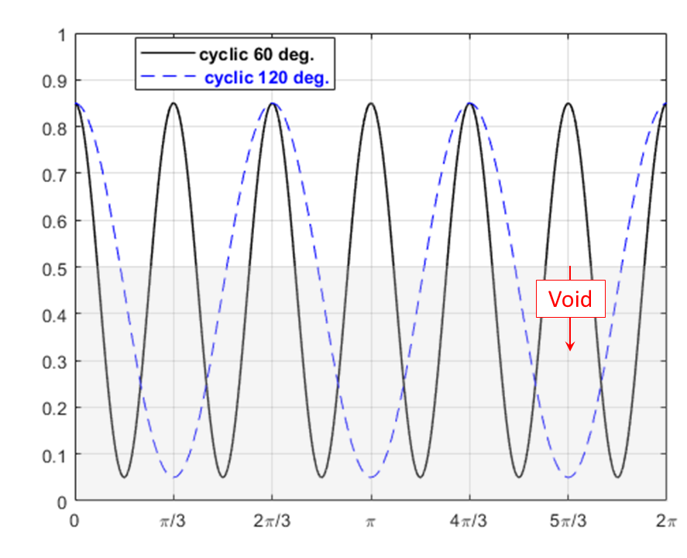
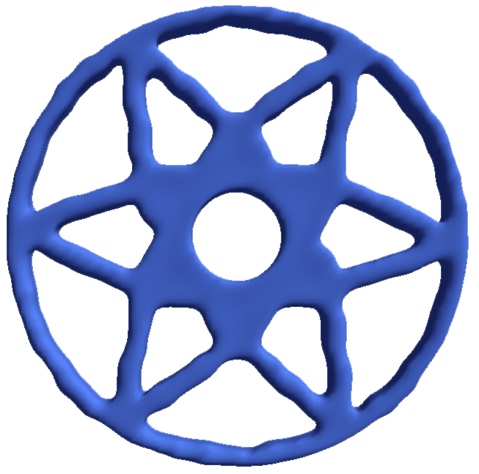
Cyclic Symmetry on Sensitivity Field

Slide 29
Questions?

